Slide 1

Salary Prediction Project
Brandon Lin

Slide 2

Problem Statement
Develop two predictive models to estimate an individual’s salary based on selected personal and professional attributes.

Slide 3
Dataset Visualization
What is the overall spread of the data?

Slide 4
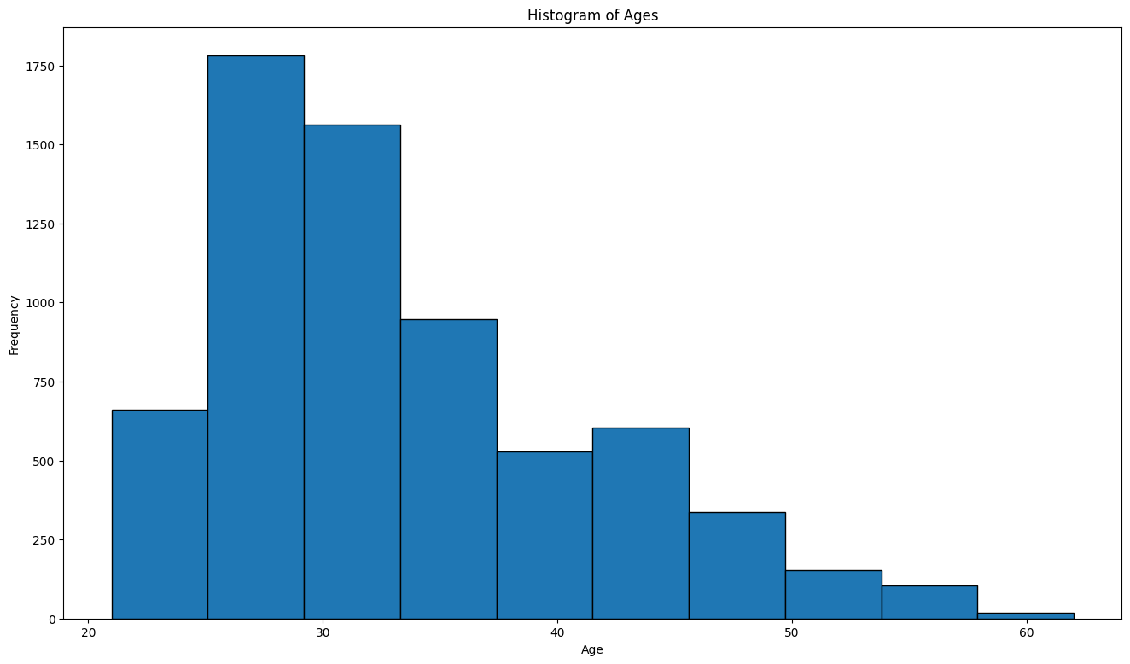
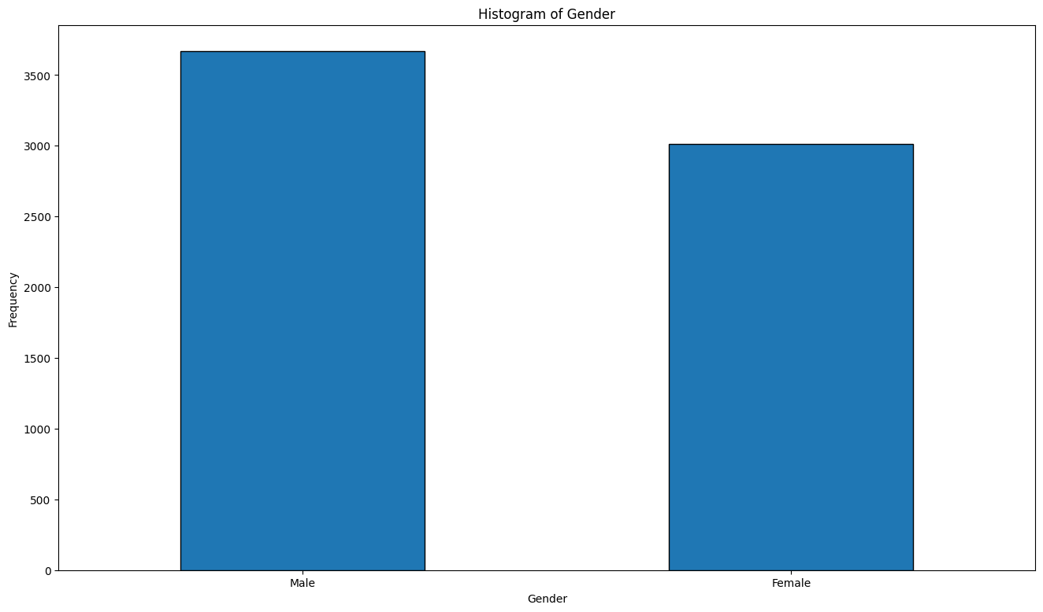
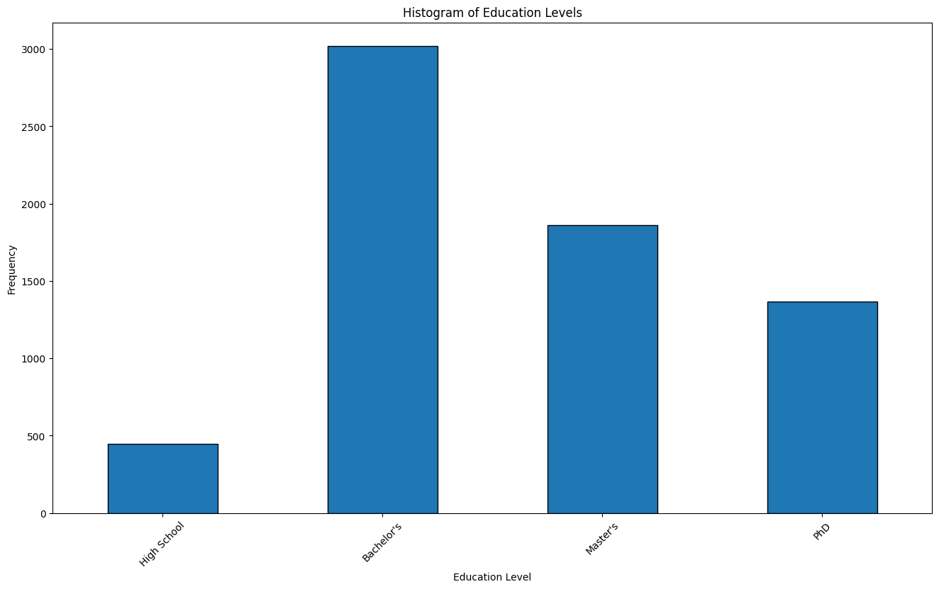
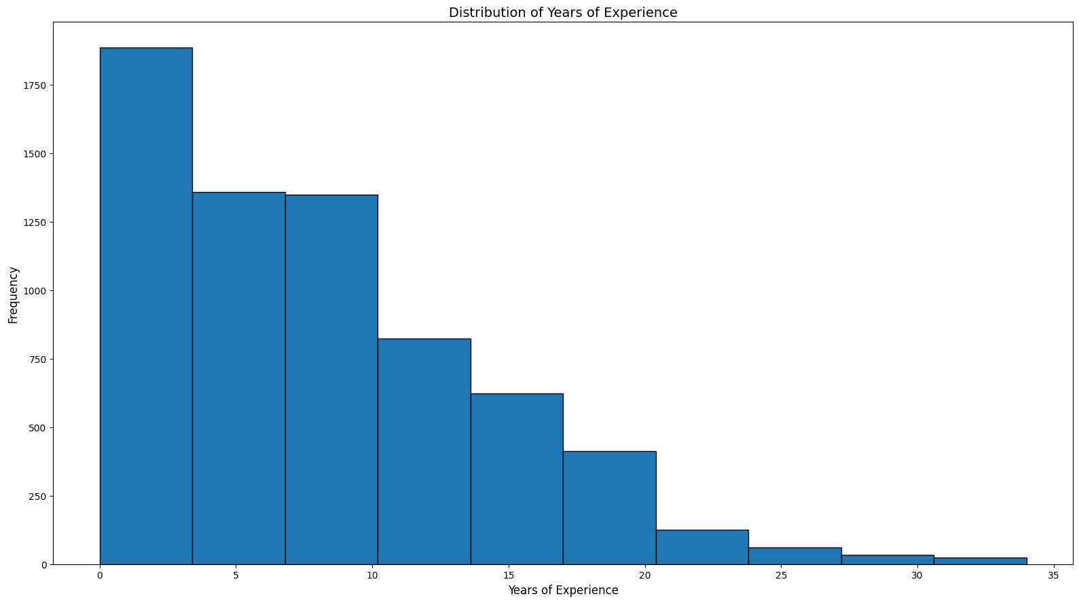

Slide 5
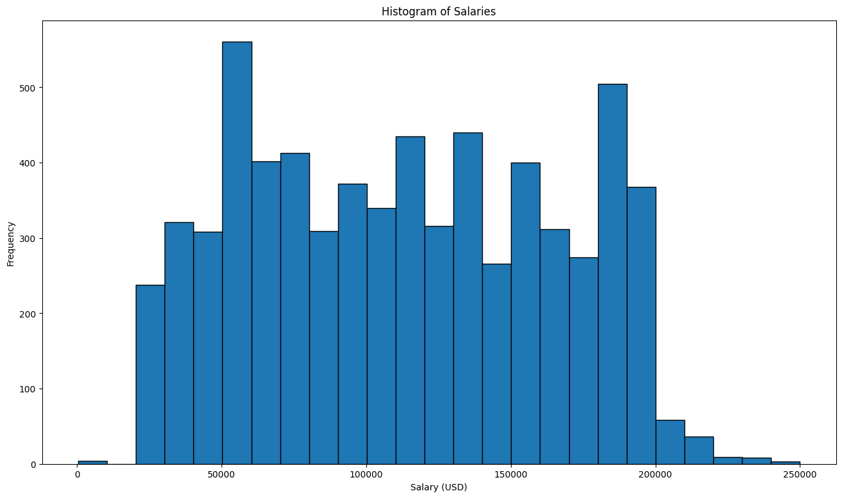

Slide 6
Relationships
Are there any relationships that are meaningful?

Slide 7
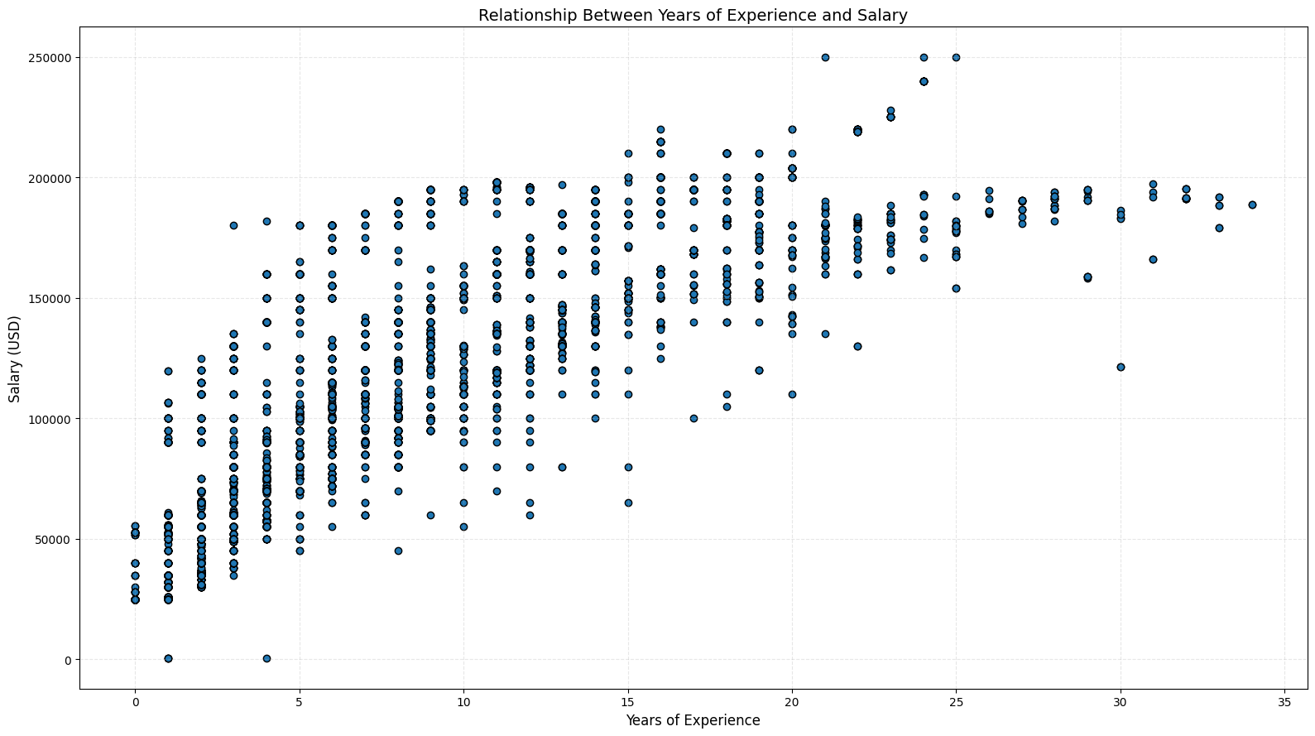

Slide 8
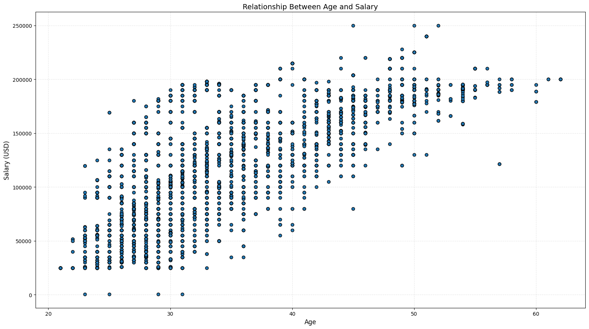

Slide 9
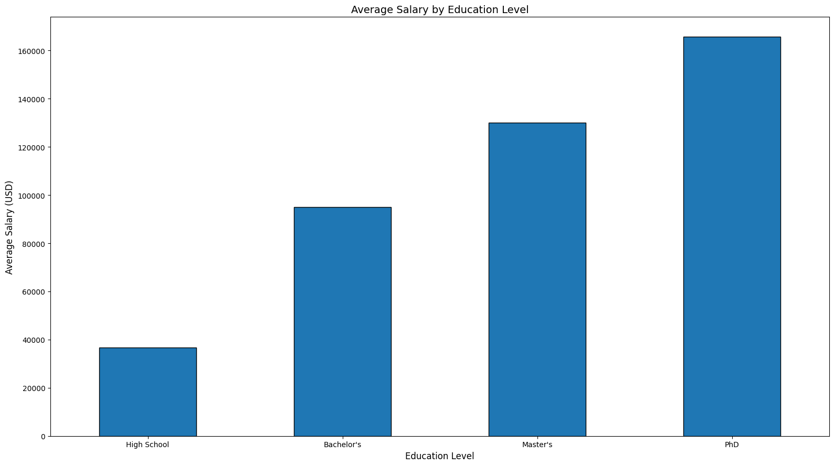

Slide 10
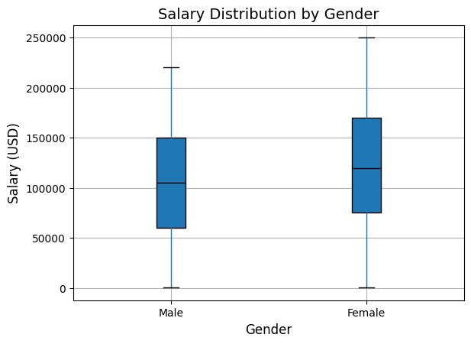

Slide 11
Reverse Pay Gap?
Is there a reason for a discrepancy in pay?

Slide 12
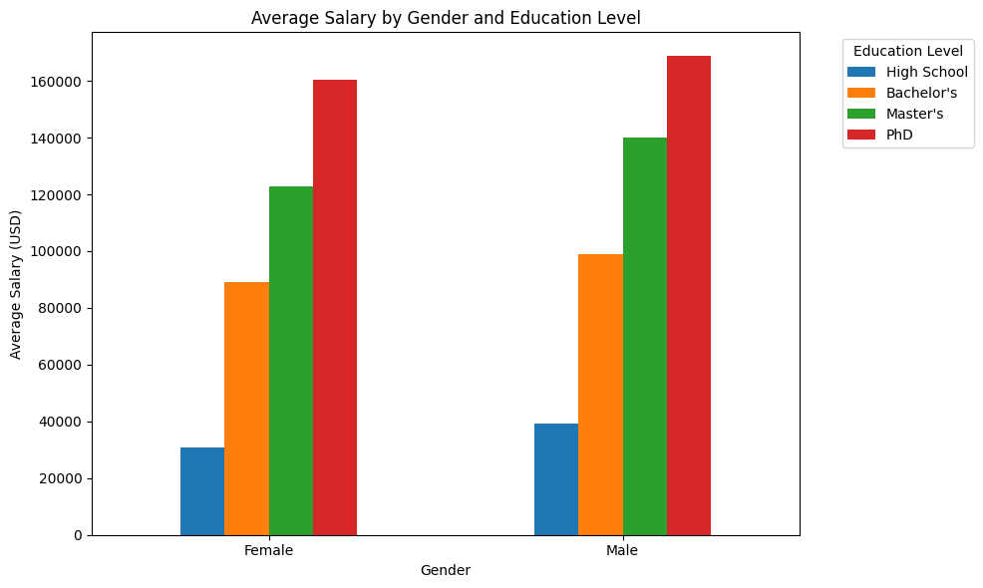

Slide 13
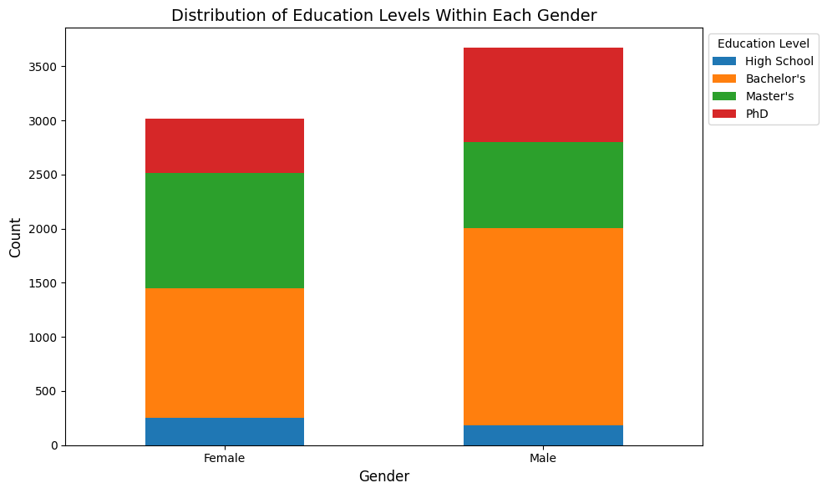

Slide 14
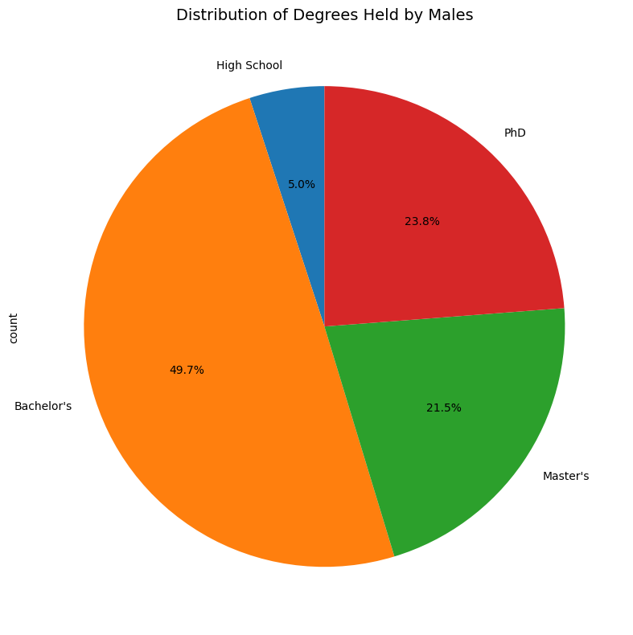
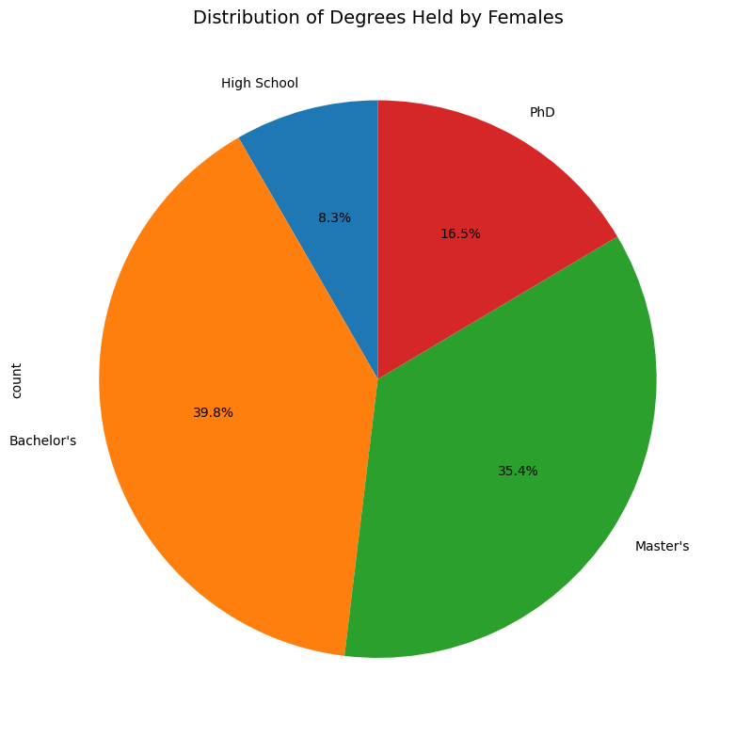

Slide 15
Heatmap
Time to analyze correlation formally

Slide 16
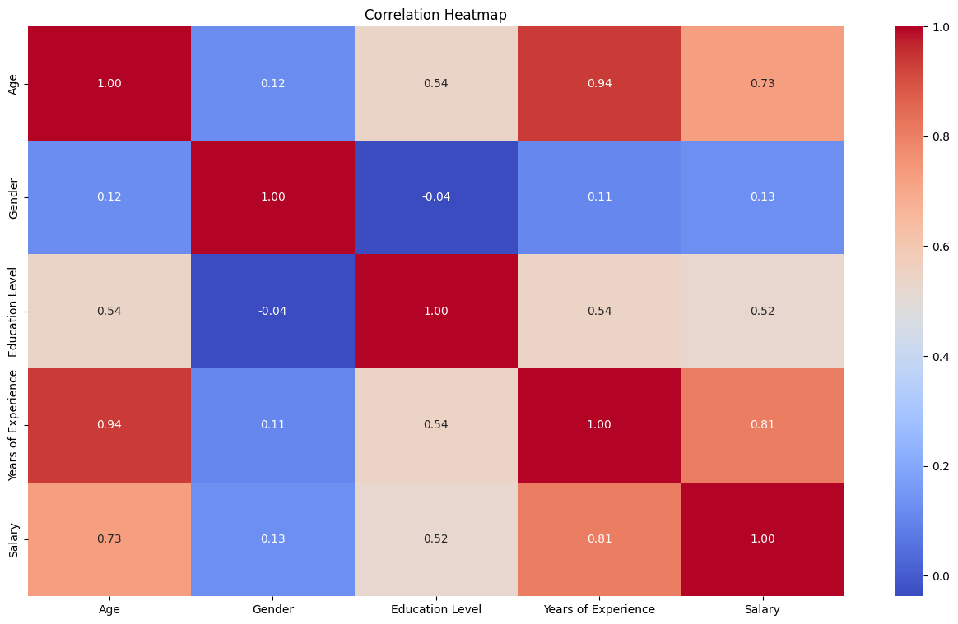

Slide 17
Predictive Models and Performance
Let’s take a look at the predictive models used

Slide 18
Models
Ridge Regression
Random Forest Regressor
Overview: A linear regression technique enhanced with L2 regularization to shrink coefficients and prevent overfitting.
Adds the squared magnitude of the coefficients (multiplied by a penalty term, λ) to the loss function.
Polynomial features was added to help the model deal with non-linear patterns.
Overview: Random Forest Regressor builds multiple decision trees during training and averages their predictions, improving accuracy and reducing variance (Ensemble Method)
Uses Bootstrap Sampling to prevent overfitting. (Bagging)

Slide 19
Model and Performance
Ridge Model
Random Forest Regressor Model
Mean Absolute Error (MAE): 0.35567413963390565
Mean Squared Error (MSE): 0.20758432457804746
R² Score: 0.797155866570255
R² Score was used because it is an easily understandable metric that indicates how well a model and its features explain the variance of the target variable.
Mean Absolute Error (MAE): 0.2032429930400899
Mean Squared Error (MSE): 0.10644569797550738
R² Score: 0.895984991125628
R²Score generally does not capture complex non-linear relationships so MSE is also used to account for that.
R² Scores too close to 1 can indicate overfitting.
0.9 could indicate overfitting; therefore, residual plots should be examined.

Slide 20
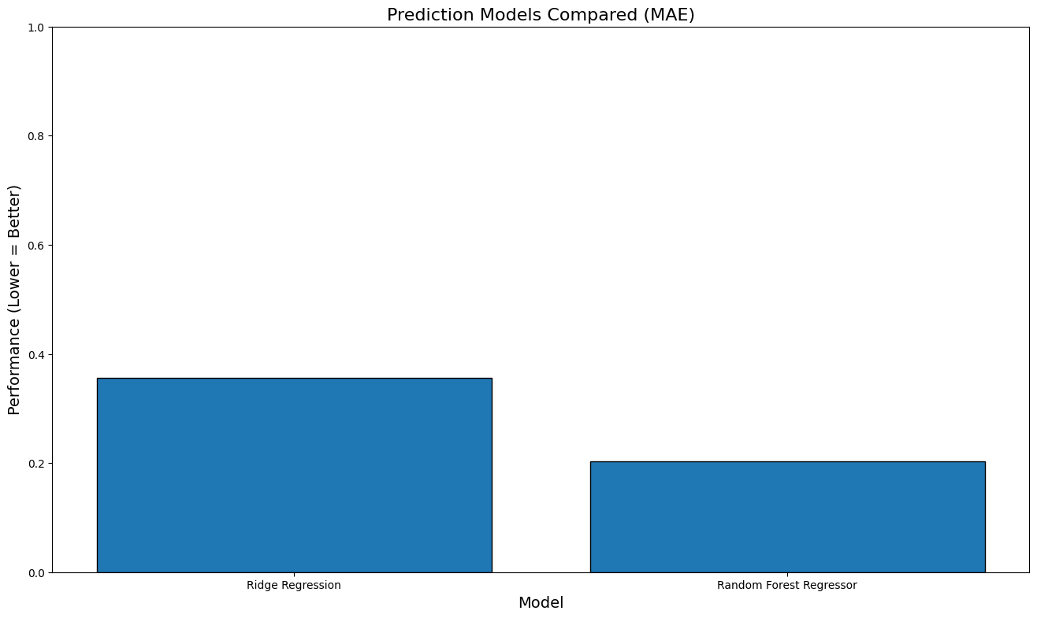
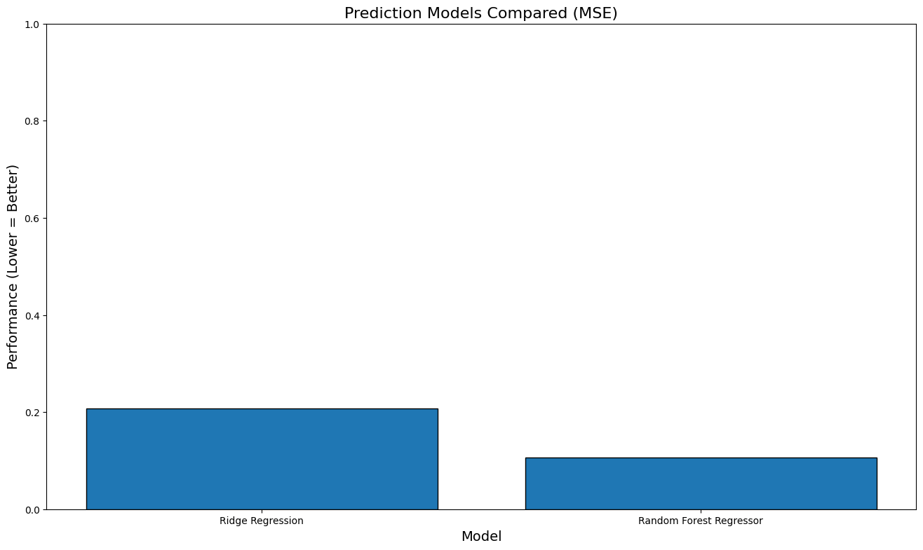
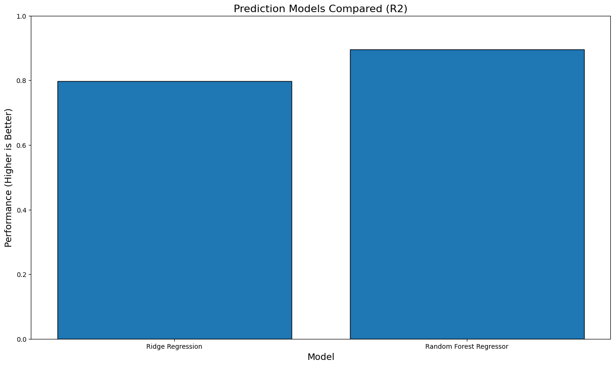

Slide 21
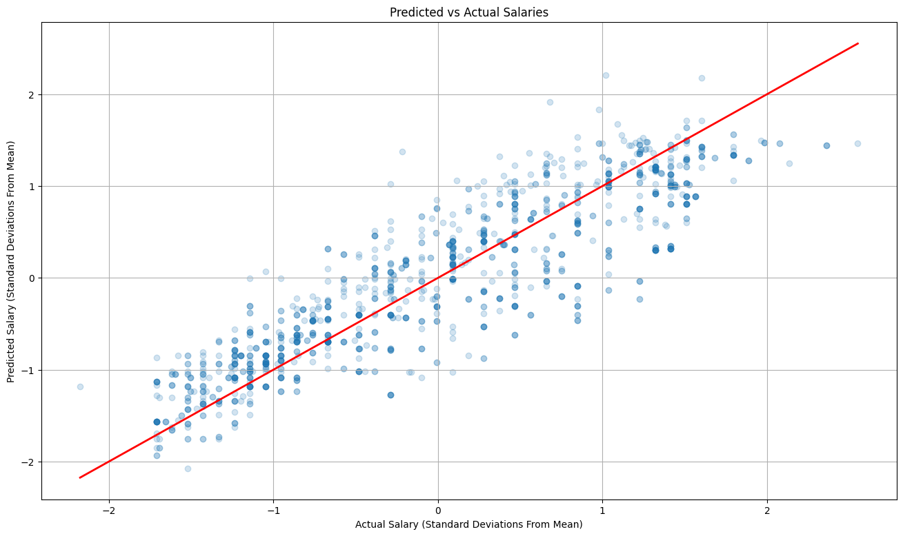
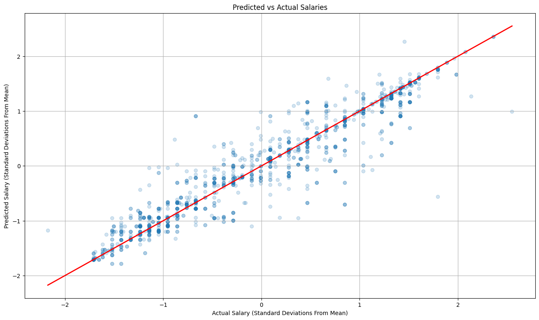
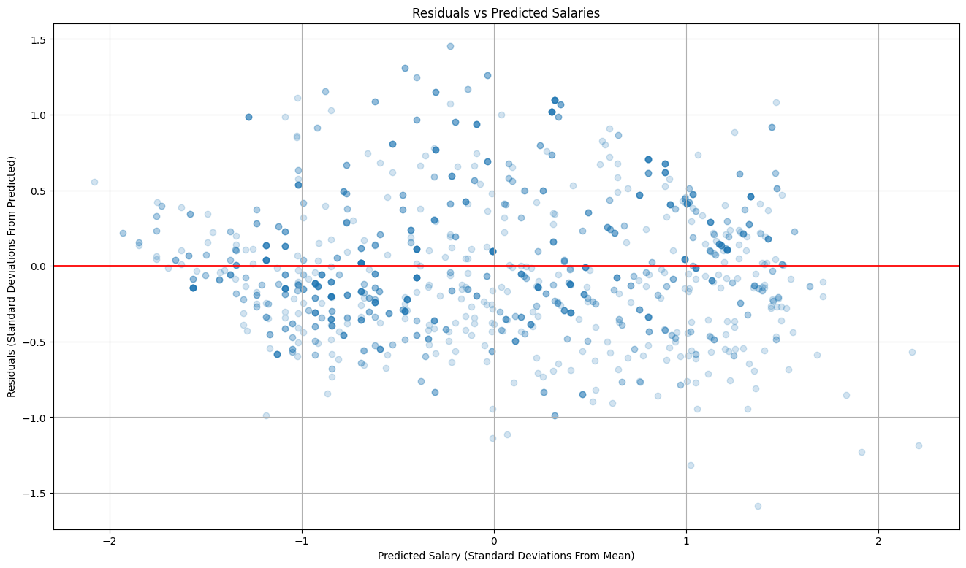
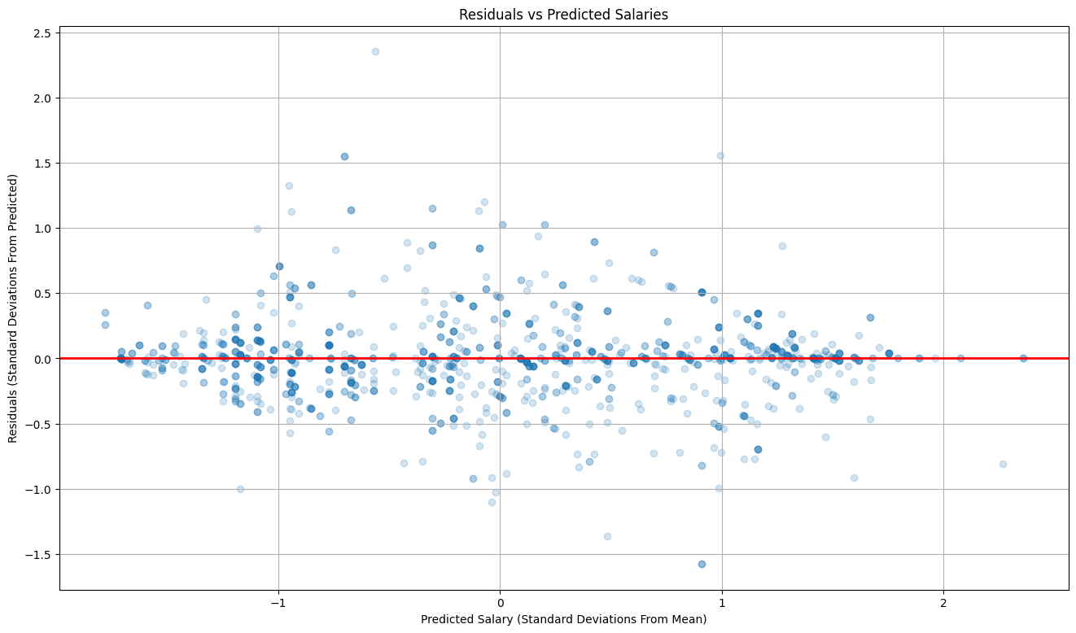

Slide 22
End
Any Questions?

Slide 23

Any Other Questions?

Slide 24

Thank You!
Thanks to all of you guys & gals for attending my presentation.

